Slide 1
I400 – Application Development in Java
Lecture 12

Slide 2
Today
CH 14 – Graphical User Interfaces
Side note on radio buttons – groups!
Creating controls in java code instead of FXML files
Shapes
Coordinates
Adding a second window to your project
Passing information between windows

Slide 3
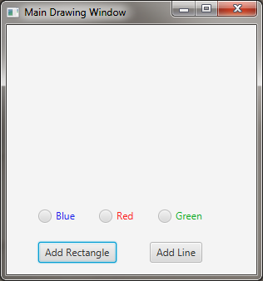
Get ready…
If not available already:
Install JavaFx
Install SceneBuilder
Set Path for Scene Builder in Eclipse
Start a new FXML project
New->Other… JafaFX/JavaFX Project
Call it DrawingExample
Create a new FXML Document
New->Other… JavaFX/New JavaFX Document
Call it DrawingLaunchPage
Create a new controller
New->Class or Source -> Generate Controller
Call it DrawingLaunchPageController
Copy and paste code from Canvas into these 3 files:
Main.java, DrawingLaunchPage.fxml, DrawingLaunchPageController.java
Make sure it runs!

Slide 4
Radio Buttons -- Groups
RadioButtons (and ToggleButtons) should only allow one option to be selected at a time.

Slide 5
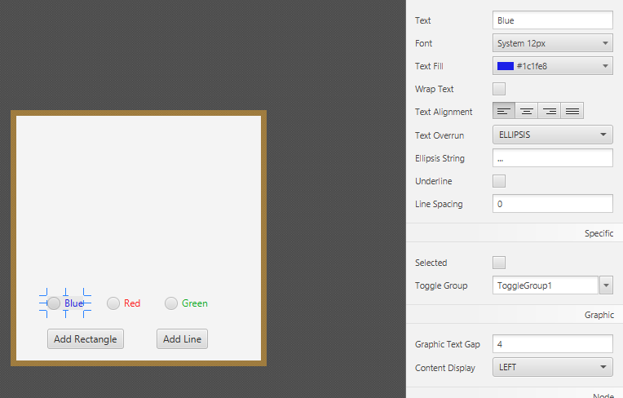
ToggleGroup in Scene Builder
You have to tell Eclipse which buttons are grouped together (Properties tab)

Slide 6
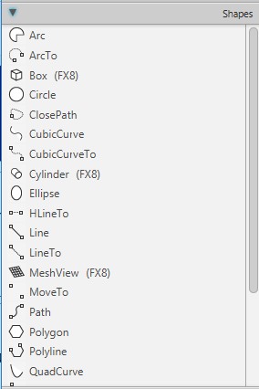
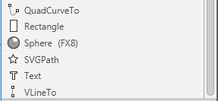
Shapes
Shape is a base class with common properties:
Fill, stroke, strokeWidth, etc…
Children of the Shape class include:
Text, Line, Rectangle, Circle, Ellipse, Arc, Polygon, Polyline, …
Scene Builder allows you to add shapes directly to your scenes…

Slide 7
Shapes
Sometimes, we want to add a shape or other control at runtime
In our example: we want to add a shape in response to a button click by the user
We can do this in an event handler…

Slide 8
Java Coordinates…
First, you need to know the Java coordinate system… (0,0) is the upper left corner
A shape’s (x,y) coordinates are nested in their parent with their upper left corner anchored to that location
(0,0)
y
(x,y)
x

Slide 9
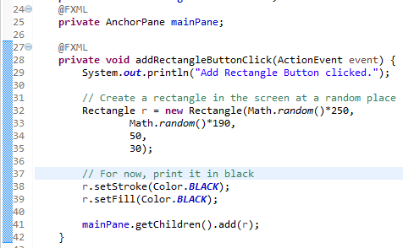
Button Click Handler
Create an event handler for the rectangleButton click
Print to the console
Create a rectangle with a random x,y (within bounds of your AnchorPane), and of size 50x30
Set rectangle to BLACK
Add it to your AnchorPane’s children

Slide 10
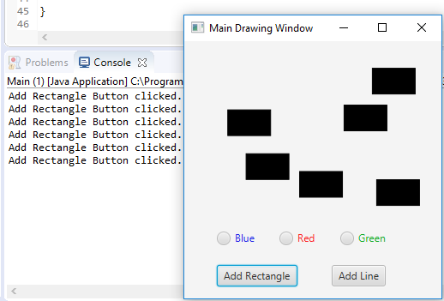
Run it!
Don’t forget to set the handler in Scene Builder!

Slide 11
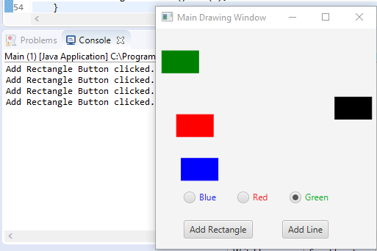
Customize the Color
Instead of printing a black rectangle, let’s find out what the user selected, and use that color (BLACK if they have not selected a color)

Slide 12
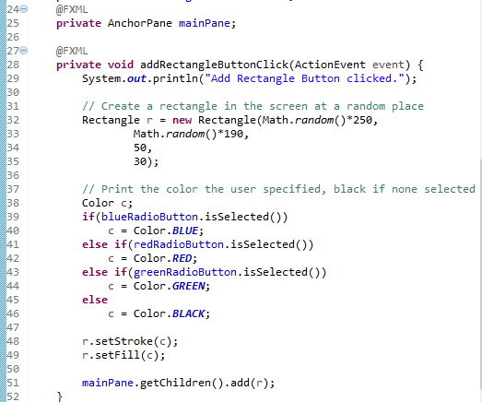
Customize the Color
We add an if statement that finds which radio button is selected, and sets a color variable c accordingly.

Slide 13
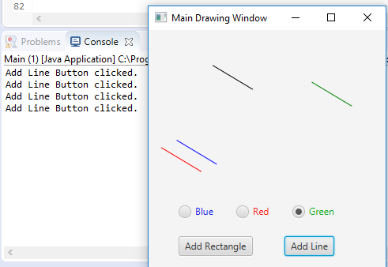
Add Line (Group Work)
Implement a handler for the Add Line button click. The line should be:
A diagonal line that is approximately the same size as the rectangle
Note: the Line constructor take 4 doubles… x and y of starting and ending points
The color the user indicates (BLACK if none is selected)
You will need to import javafx.scene.shape.Line;

Slide 14

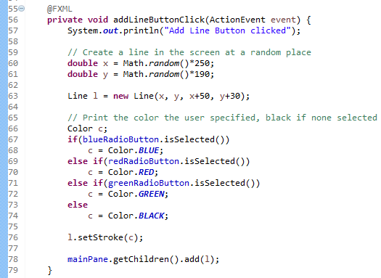
Add Line Solution

Slide 15
IMPORTANT
Scene Builder lets you add shapes to your scenes, but…
For HW2, 14.11 should be implemented in the java code, not in an .fxml file
You can implement it with shapes in Main.java instead of using an event handler like we did today

Slide 16
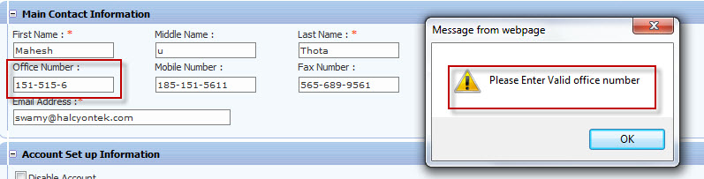
Multiple Windows
Often, we use Pop-up windows to inform the user of important information:
Getting JavaFX to pass control between windows takes several steps!

Slide 17
Multiple Windows
Steps to Create and Link Windows
Use Scene Builder to design a second window
Create controller for the second window
Add accessor methods in controller(s)
Link controllers: In one controller, get the other controller and use accessor methods to pass information between

Slide 18
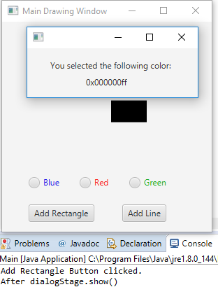
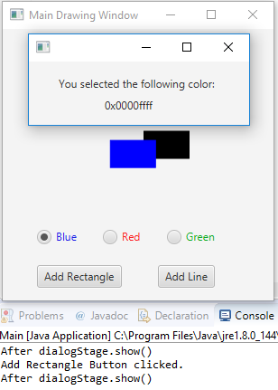
Example: Warning Dialog
Have a window pop up and display the color code of the color of the rectangle

Slide 19


1. Design a second window
Create a WarningDialog FXML file
Give your AnchorPane a size (mine is 250 x 75)
Add two Labels
Give the bottom Label an fx:id of colorLabel
Save

Slide 20
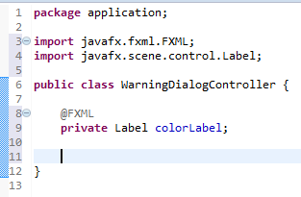
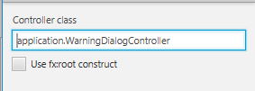
2. Create controller for 2nd window
Create a WarningDialogController
Make sure to link this in Scene Builder

Slide 21
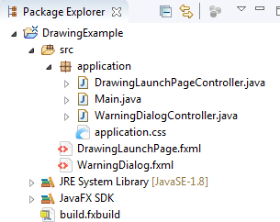
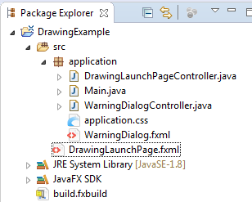
Project Structure
Your FXML Project, DrawingExample, should have this structure:
If it has this structure instead, you’ll get an error!

Slide 22
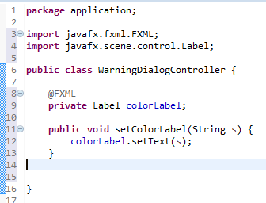
3. Add Accessor methods in controller

Slide 23
4. Link Controllers
Open DrawingLaunchPageController.java
Add this additional import:
import javafx.fxml.FXMLLoader;

Slide 24
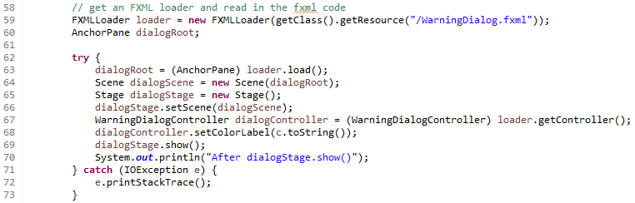
4. Link Controllers
At the end of the addRectangleButtonClick method,
Load the new window (looks a lot like Main.java)
Get the controller
Use the accessor on the controller
1
2
3

Slide 25
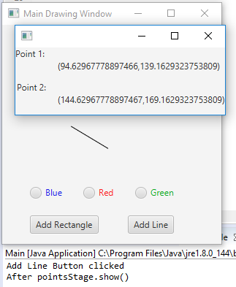
Add Second Window
When the Add Line button is clicked, display a second window that has a Label with the (x,y) coordinates of the two points that make the line.
Your new window controller should have a setter that takes four doubles (x1,y1, x2, y2) and sets the two Labels accordingly

Slide 26
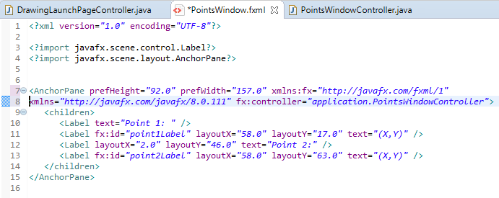
Add Second Window Solution

Slide 27
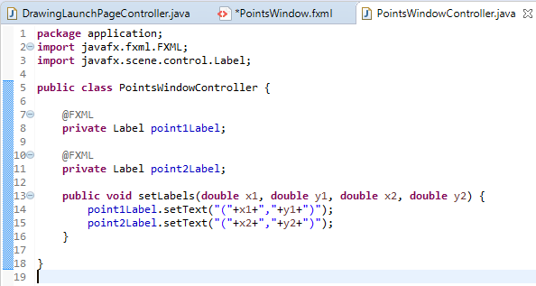
Add Second Window Solution
Controller had one accessor method

Slide 28
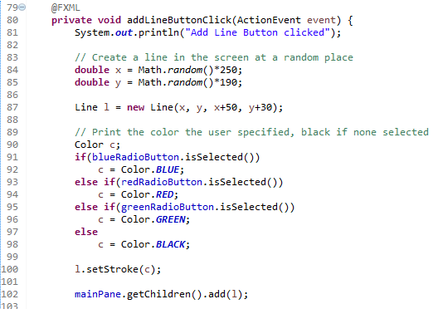
Add Second Window Solution
First part of addLineButtonClick is unchanged

Slide 29
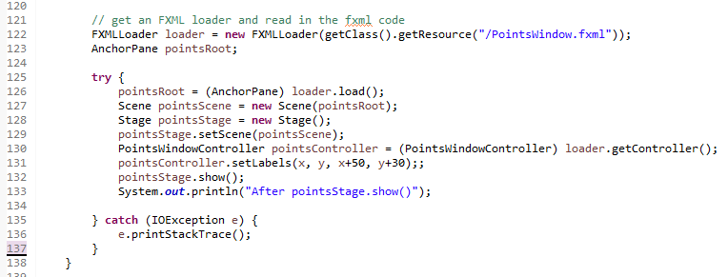
Add Second Window Solution
Add this code to addLineButtonClick:

Slide 30
Questions?

